Slide 1
Full STEAM Ahead @ the Library
Created by:
Sara Edwards, Erin Hitchcock,
and Karen Vill
through a Study Group sponsored by the Teacher Center of Broome County, Winter 2019

Slide 2
What is STEAM?
STEAM stands for Science, Technology, Engineering, Art, and Math.

Slide 3
Benefits of STEAM Education
1
STEAM education helps students connect the dots, solve problems, and think creatively. It is taking an integrated approach to encourage students to think more broadly about real-world situations.

Slide 4
Why the Library?
Space: Library Media Centers tend to have the most open space.
Furniture: Tables and chairs can be used/moved around.
Supervision: Library Media Centers are staffed by librarians and/or aides who can help monitor and support students.
Access: Library Media Centers are open all day, giving students opportunities throughout the day to access the space.
(from chapter 3 of Your Starter Guide to Makers Spaces, by Nicholas Provenzano)

Slide 5
How to Incorporate STEAM Activities
If you have a budget to spend on STEAM activities, there are some great options!

Slide 6
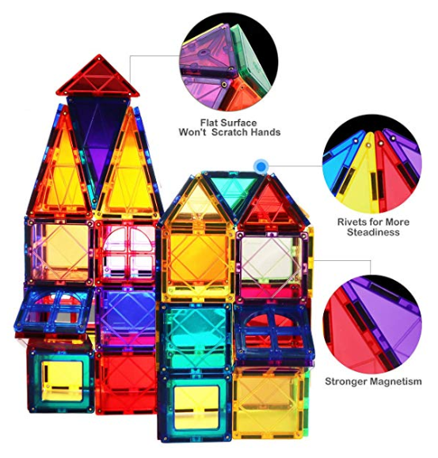
Magnetic Building Blocks
Magnetic tiles can develop intelligence, engage imagination and start on a road of discovery. Because of magnetic force, any two pieces can be drawn together and these blocks can be used to make various structures. Pieces can be combined into a variety of modeling blocks (housing, transportation, people, animals, large amusement park, etc.). (Various
prices on Amazon, often about $.50 per piece.)

Slide 7
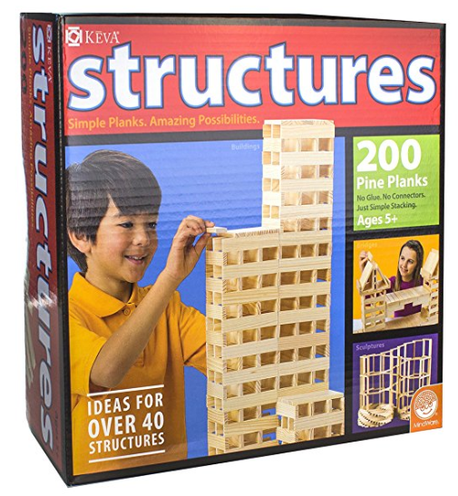
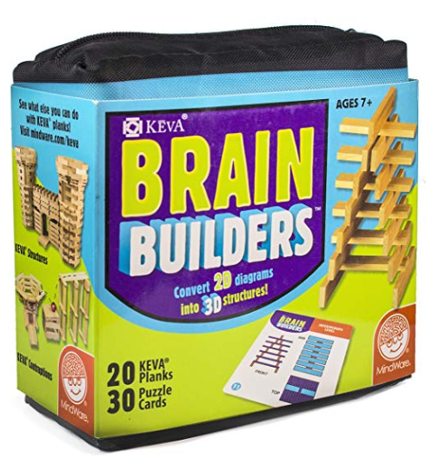
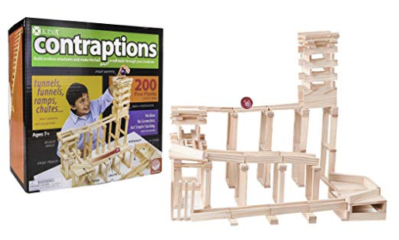
KEVA Blocks
Wooden planks you can use to build any structure. The planks can even be stacked upright. Prices vary depending on package. The basic 200 pine planks cost about $50.
Lesson plans & ideas: http://www.kevaplanks.com/lesson-plans-challenges-games-activities

Slide 8
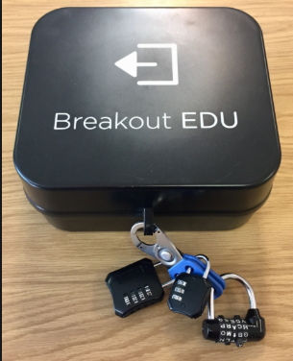
Breakout Boxes
Academic games or escape room where students work in groups and use critical thinking skills to solve a series of puzzles in order to open a locked box.
A single kit (1 kit, 1 access to website) costs $150.
https://www.breakoutedu.com/ getstarted

Slide 9
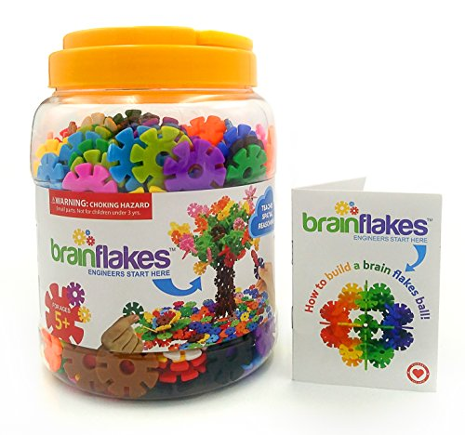
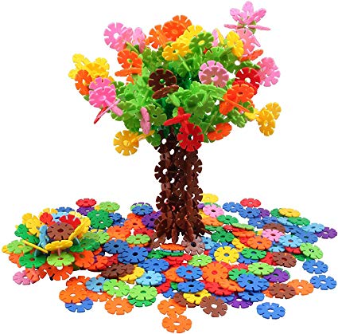
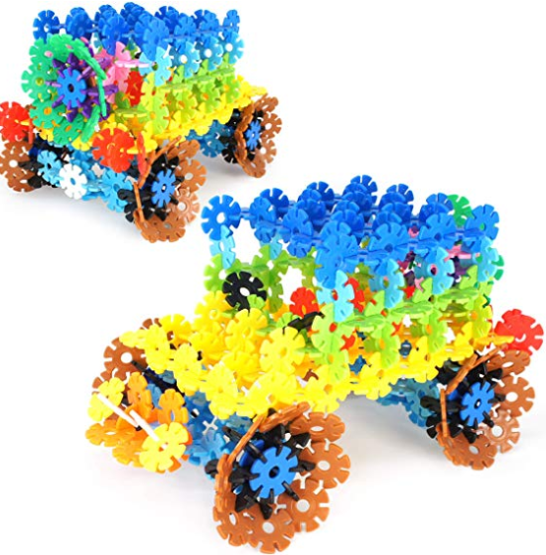
Brain Flakes Interlocking Discs
BrainFlakes are small, colorful, round interlocking plastic pieces. Think outside the box and make your own creation, or copy something featured on the Viahart website. ($15 for a set of 500 on Amazon.)

Slide 10
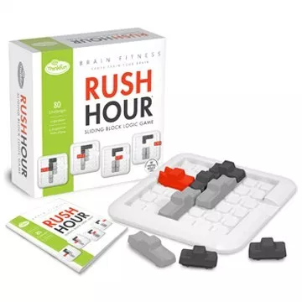
Rush Hour Brain Fitness
Set up your cars according to one of 80 Rush Hour challenges and then battle the gridlock by sliding vehicles out of your way to find a path for your red car to exit. A logic game that will test problem-solving skills. ($20 on Amazon)

Slide 11
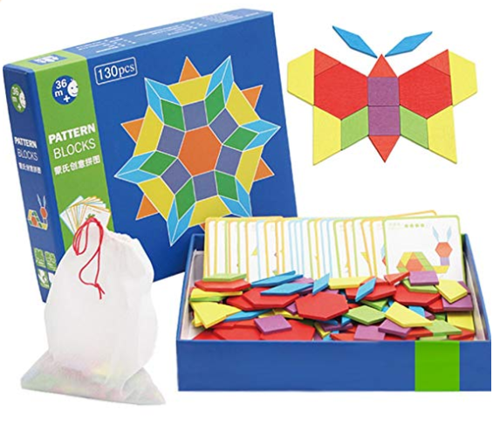
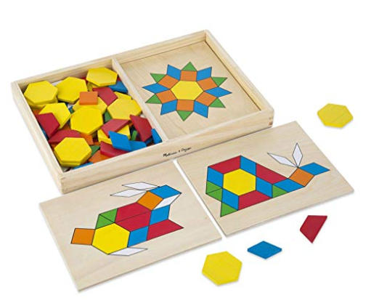
Pattern Blocks
Use brightly colored blocks
to create patterns or images.
Tangrams could be used in the same way, but these pattern blocks come with 130 pieces. ($15 on Amazon)
Lessons and Ideas
https://www.hand2mind.com/resources/glossary-of-hands-on-manipulatives/pattern-blocks

Slide 12
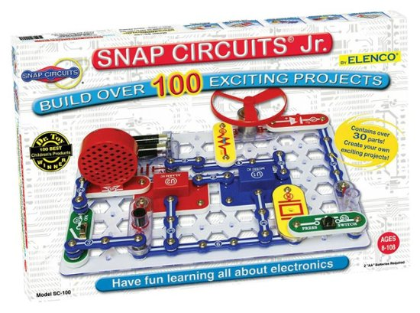
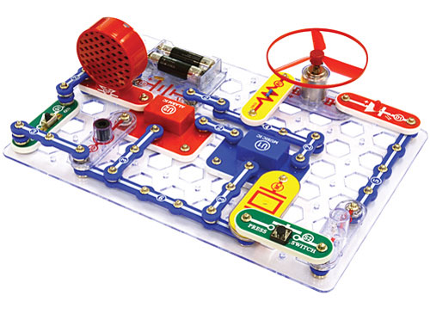
Snap Circuits
Use building blocks with snaps to build different electronic circuits. Each block has a function -- switch blocks, lamps, alarms. The included booklet contains many ideas to build circuits.
There are several different levels of Snap Circuits. The Junior version ($20 on Amazon) is ideal for elementary, and is advertised as being for ages 8-108.

Slide 13
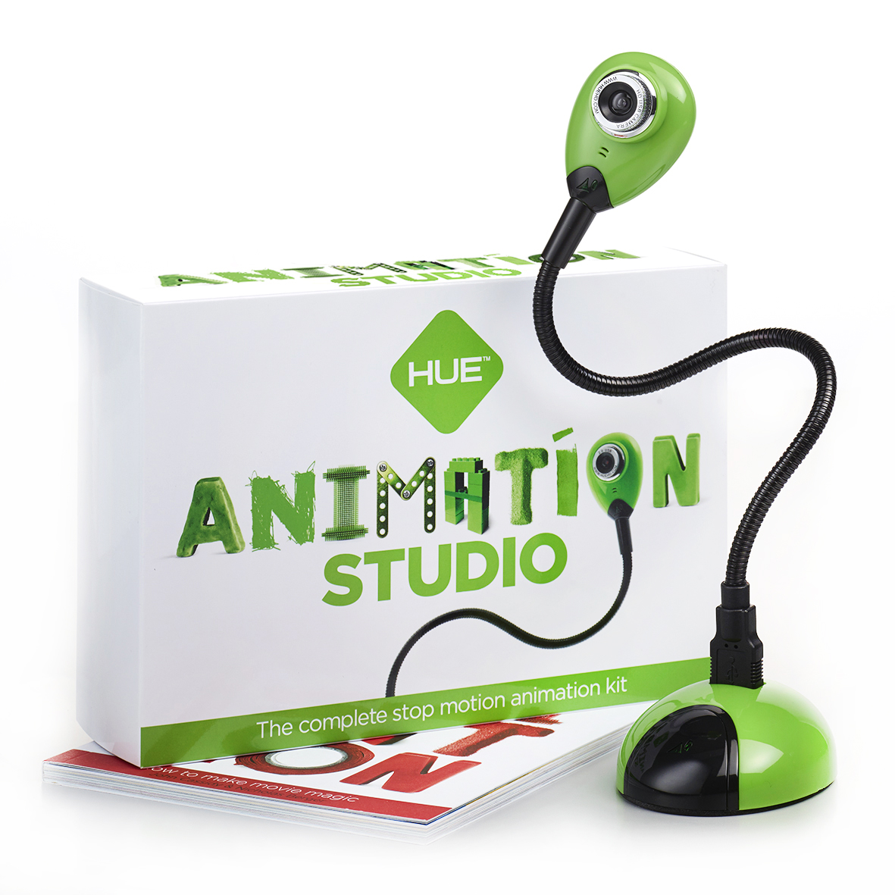
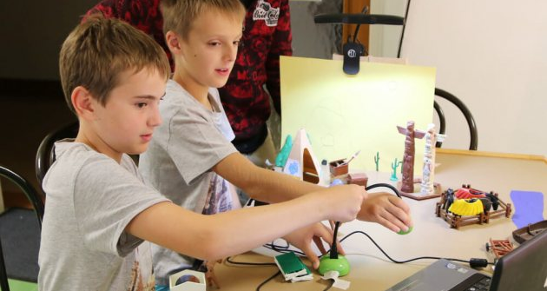
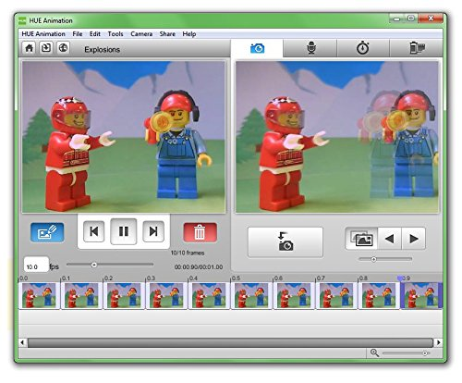
Hue Animation Studio
Use this kit to create stop animation videos with toy or even human subjects. The kit includes a camera and software. ($60 on Amazon)

Slide 14
STEAM on a Budget
But you don’t have to spend a lot of money to do some great STEAM activities with your students!

Slide 15
Teacher Center of Broome County
The Teacher Center of Broome County serves many of the schools in this area.
Many STEAM items are available to borrow, including:
Dot & Dash robots
Hue Studio Animation kits
Breakout boxes

Slide 16
BOCES School Library System
The BOCES Media Library has many STEAM activities that can be borrowed.
Items include:
SNAP Circuits (various levels; classroom sets available)
Little Bits
Makey Makey
Joinks
Straws & Connectors
HUE Animation Kits
Osmo Genius Set
Ozobots
Puzzlets

Slide 17
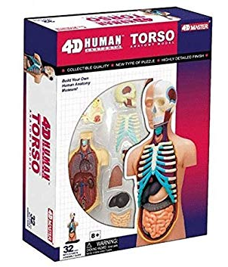
Local Public Libraries
The Your Home Public Library (Johnson City) has a Discovery Collection. Other local libraries may have similar collections you can borrow.
Items include:
Mini torso model/anatomy puzzle
Science kits
Microscopes
Pattern blocks
Potato clock
Mathlink cubes
K’nex set
Snap circuits

Slide 18
Dollar Stores & Yard Sales
Jigsaw puzzles (surprisingly many students don’t seem to mind when pieces are missing)
Jenga
Building blocks
Arts & Crafts materials -- felt, pipe cleaners, construction papers, glue, pompoms, etc.

Slide 19
Paper Activities
Boggle
Tangrams
Coloring sheets
Mazes
Origami
Paper building blocks (https://babbledabbledo.com/science-for-kids-paper-building-blocks/)
Use Flippity.net to create word searches, crosswords, bingo, and more

Slide 20
Internet Activities
Interland
Code.org
Kodable
Frugal Fun 4 Boys & Girls STEM Activities
Common Sense Media

Slide 21
Further Resources - Professional Books
These are some of the books we consulted. Many of these titles are available to borrow from the Teacher Center of Broome County.
STEAM Lab for Kids (Liz Heinecke)
Your Starter Guide to Maker Spaces (Nicholas Provenzano)
STEAM & STEAM Next-Gen Program (Sumita Mukherjee)
The Big Book of Maker Space Projects (Colleen Graves & Aaron Graves)
50 STEM Labs Science Experiments for Kids (Andrew Frinkle)
STEM Labs for Middle Grades (Mark Twain Media)
Launch: Using Design Thinking to Boost Creativity and Bring Out the Maker in Every Student (John Spencer & A.J. Juliani)
GeniusHour (Andi McNair)
Smithsonian Maker Lab: 28 Super Cool Projects (Jack Challoner)
STEAM Makers (Jacie Maslyk)

Slide 22
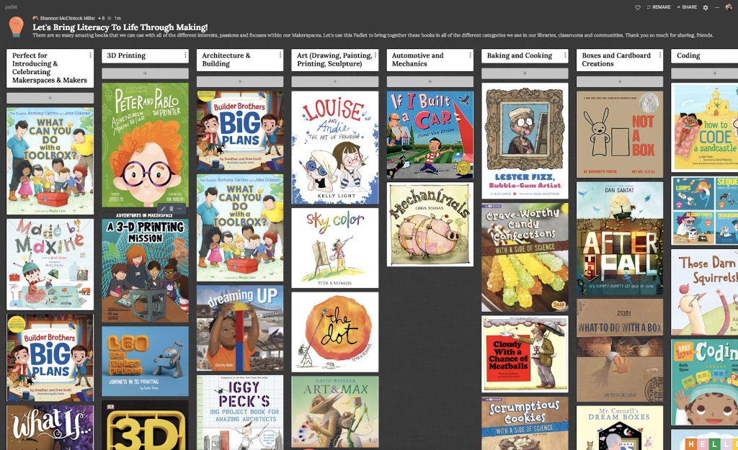
Further Resources - Books for Students to read and enjoy

Slide 23
Further Resources - Selected Websites
Check out these websites for more information and ideas:
WizKids Club
STEAM Ahead DIY for Kids free ebook
Why is STEAM important?
5 Major Benefits of Integrating STEAM Education
The Benefits of Teaching STEAM Lessons

Slide 24
Credits
Special thanks to the people who made and released these awesome resources for free:
Presentation template by SlidesCarnival
Photographs by Unsplash
And extra special thanks to Panera for unknowingly hosting and feeding us during our Study Group meetings.

